Slide 1
Weekly meeting 7
Shengya Guo, CR/AVS3, 07.08.2024

Slide 2
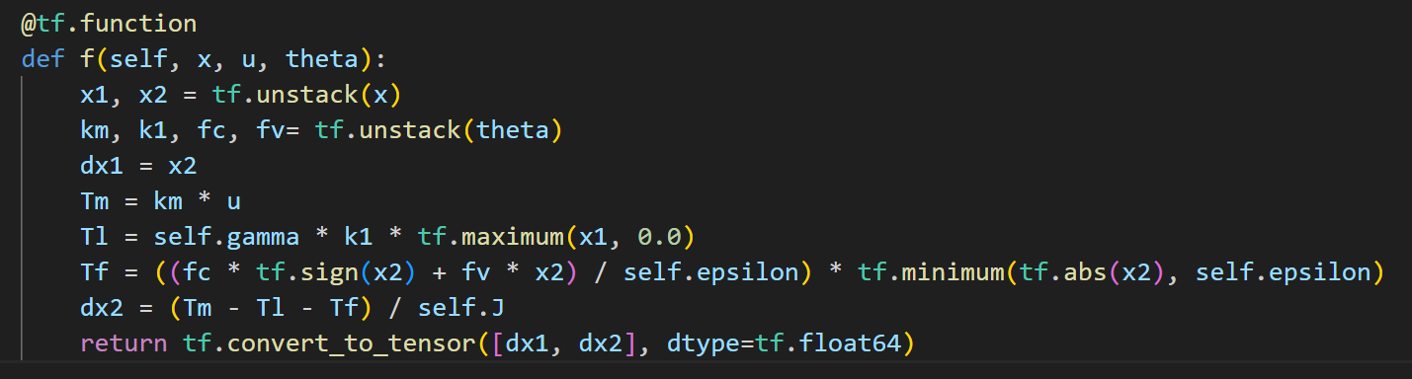
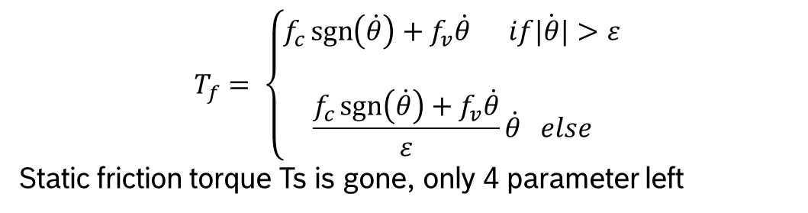
Continues function instead of uncontinues function
$$T_{f}= \left\{\begin{aligned}f_{c}\operatorname{sgn}\left(\dot{θ}\right)+f_{v}\dot{θ} if\dot{|θ|}&>ε \\ \\ \frac{f_{c}\operatorname{sgn}\left(\dot{θ}\right)+f_{v}\dot{θ}}{ε}\dot{θ} else\end{aligned}\right.$$
Static friction torque Ts is gone, only 4 parameter left

Slide 3
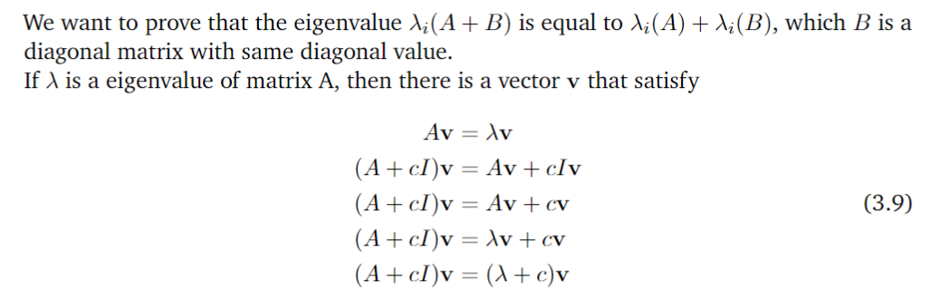
Initialize the FI matrix
The det of FI matrix will be 0 in the first 4 step

Slide 4
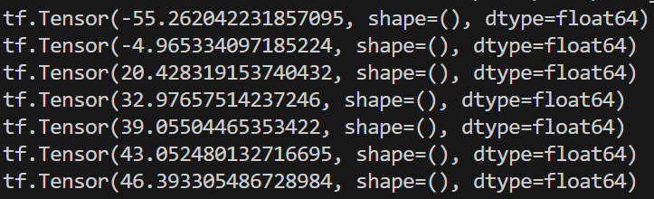
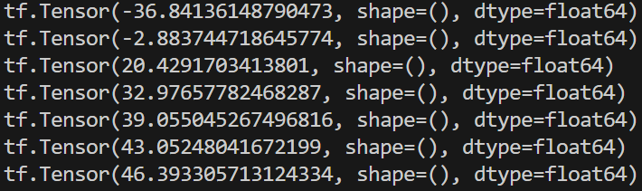
Result with different initial FI matrix
Record the total reward each 50 time step
M_init | np.eye(4) * 1e-6 | np.eye(4) * 1e-4
log det(M_init) | -55.26 | -36.84

Slide 5
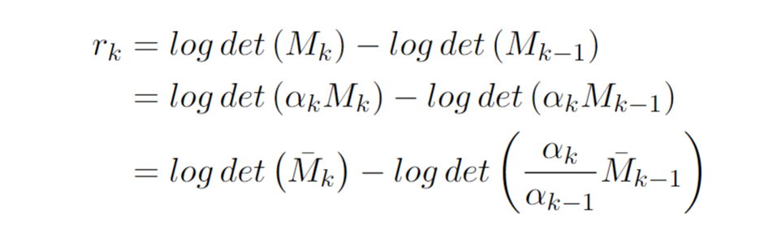
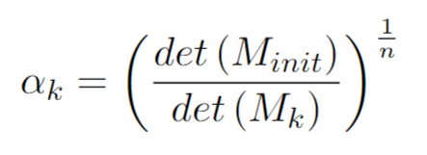
Rescale FI matrix
r_k is the step reward

Slide 6
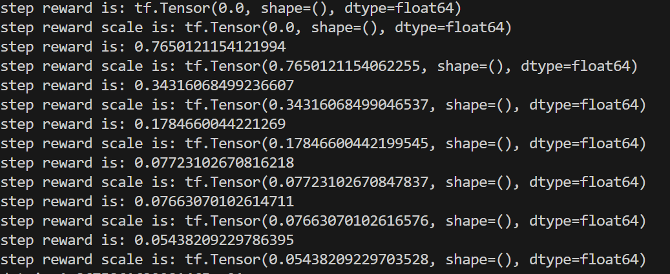
Result with rescale FI matrix
Record the setp reward each 50 time step

Slide 7
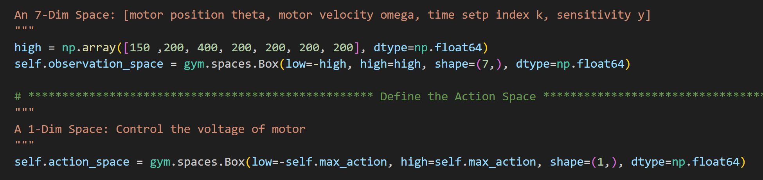
Gym environment
the time step index, the system measurements, and the elements of the FIM

Slide 8
Next
Use RNN for history dependent policy
Asymmetric AC, the value network get full info but actor learns from the partial observability

